Slide 1


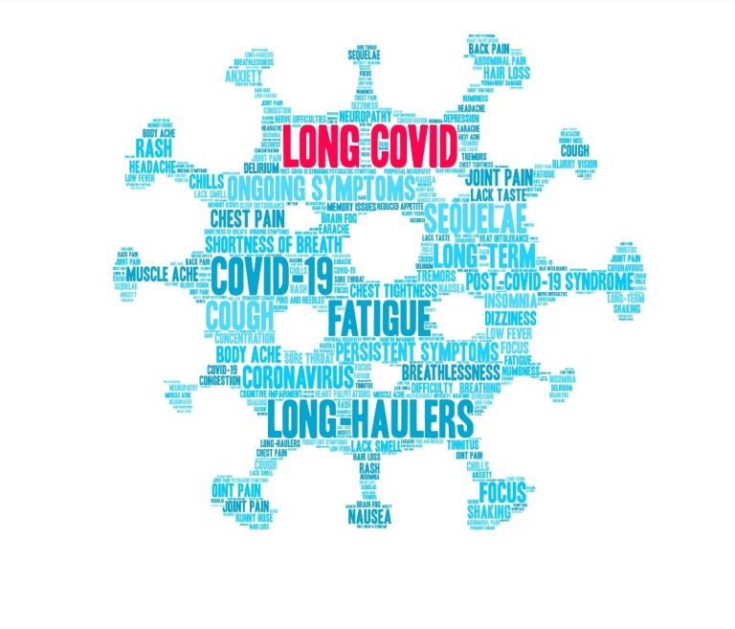




Identification of Natural Remedies for Long COVID Based on Hub Gene Biomarkers and Repurposed Drugs
Dinesh Davagandhi
Faculty of Health and Life Sciences
Supervisor: Dr Suresh Kumar

Slide 2
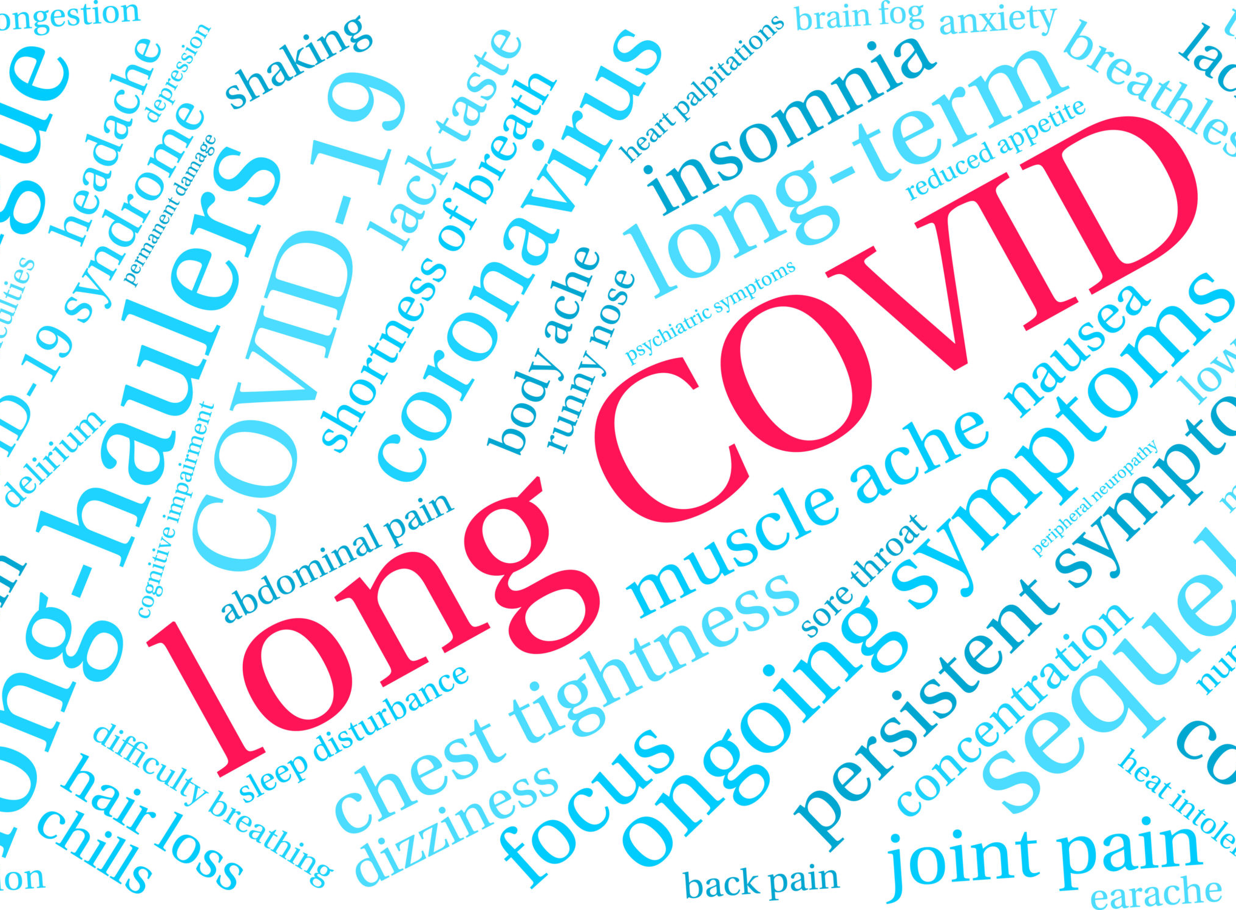


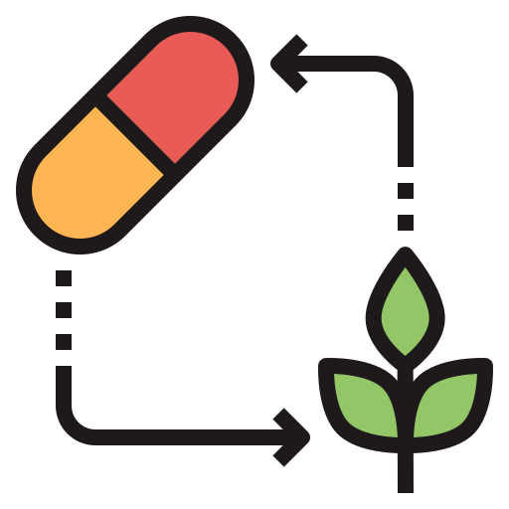
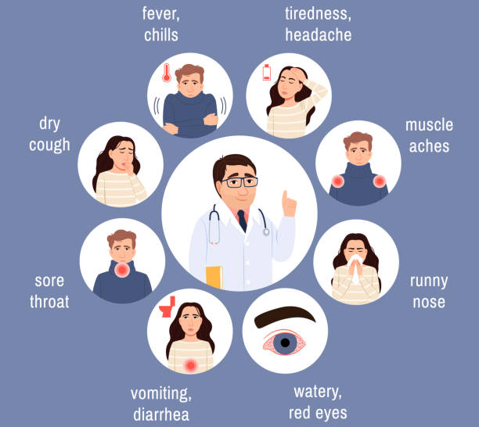
Introduction
The manifestation of the symptoms has been identified to be correlated to not a singular organ system but to multiple organ systems; Resulting in a broad range of symptoms.
Treatment for long COVID is a complex process; No treatment or drug is effectively able to cover the wide range of symptoms.
Natural products or compounds as natural remedies for long COVID is a field of research that could provide promising therapeutic drugs
Long COVID - defined as the wide range of symptoms that persists for over weeks and months experienced by COVID-19 survivors.

Slide 3
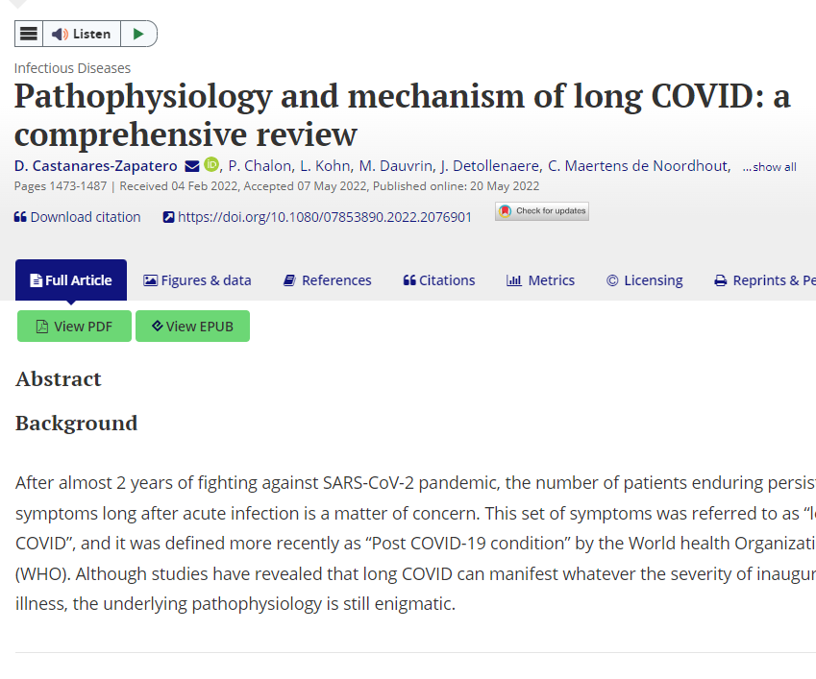
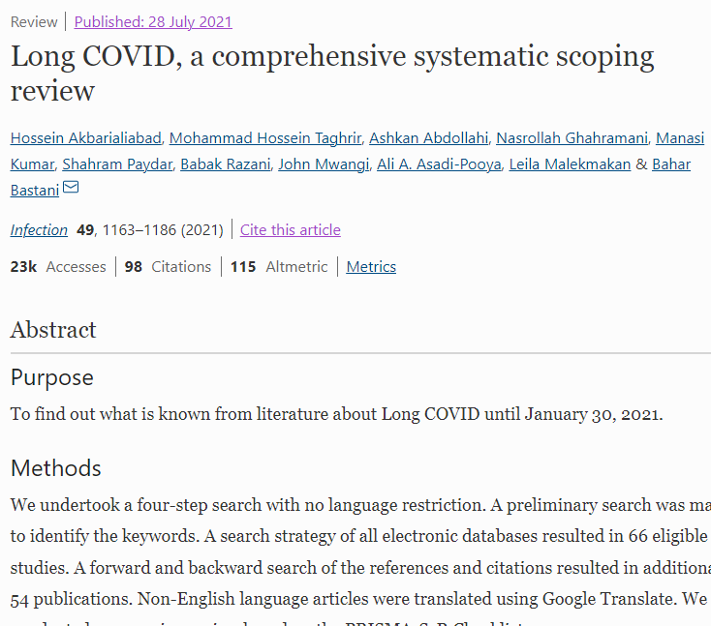
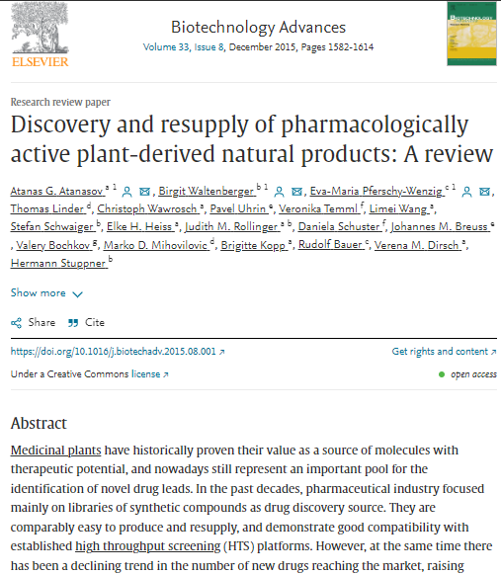
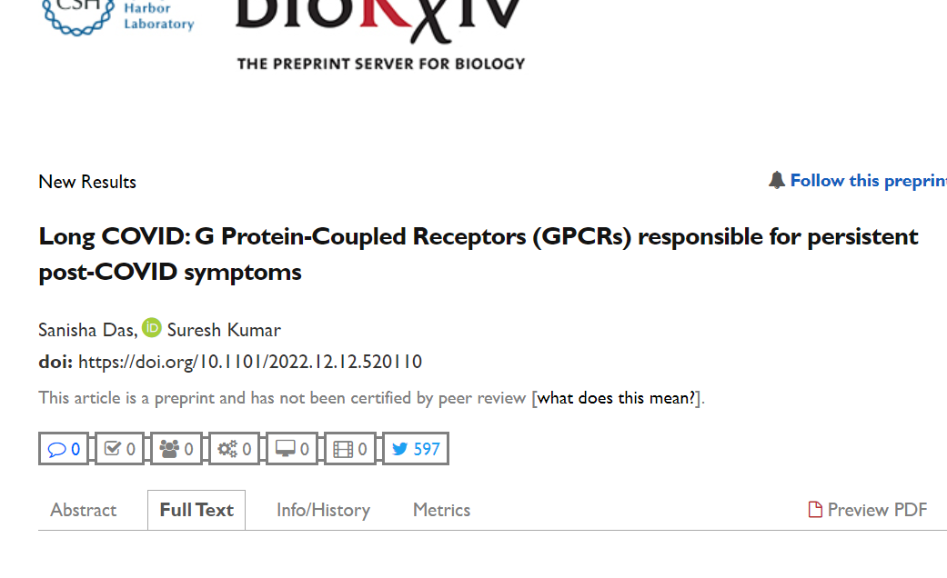
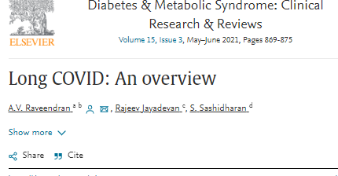
Literature Review
What is Long COVID; an Overview
Mechanism Behind Long COVID
Hub Gene Biomarkers + Repurposed Drugs
Treatment Options for Long COVID
Natural Products and Remedies; Properties and Function

Slide 4

Literature Review
“Long COVID” is a term used to describe presence of various symptoms, even weeks or months after acquiring SARS-CoV-2 infection irrespective of the viral status. Long COVID can be divided into two stages-post acute COVID where symptoms extend beyond 3 weeks, but less than 12 weeks, and chronic COVID where symptoms extend beyond 12 weeks (Raveendran et al., 2021)
The identification of the 255 symptoms in the different organ systems, the biomarker discoveries, and the respective FDA-Approved repurposed drugs, as well as their associated gene ontology and pathway insights from this study (Das & Kumar, 2022).
The mechanisms underlying its pathophysiology are still unclear. Although organ damage from the acute infection phase likely accounts for symptoms, specific long-lasting inflammatory mechanisms have been proposed. (Castanares-Zapatero et al., 2022)
Medicinal plants have historically proven their value as a source of molecules with therapeutic potential, and nowadays still represent an important pool for the identification of novel drug leads (Atanasov et al., 2021).

Slide 5

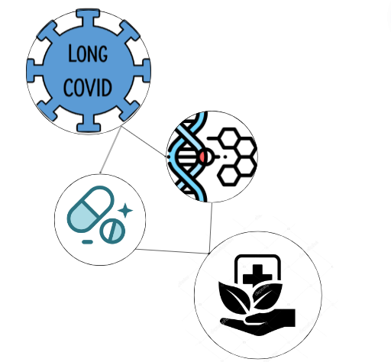
Problem Statement
“What natural remedies can target the persistent symptoms of Long COVID with the aid of the hub gene biomarkers and repurposed drugs?”
Long COVID is a disorder marked by symptoms that persist after the acute phase of COVID-19 infection. To treat these symptoms, which ultimately decrease individual's standard/quality of life, it is necessary to identify effective and accessible natural remedies to alleviate the symptoms. Additionally, the study and further examination of the identified hub gene biomarkers of long COVID and associated repurposed drugs could offer important insights into prospective therapeutic approaches for this condition.

Slide 6
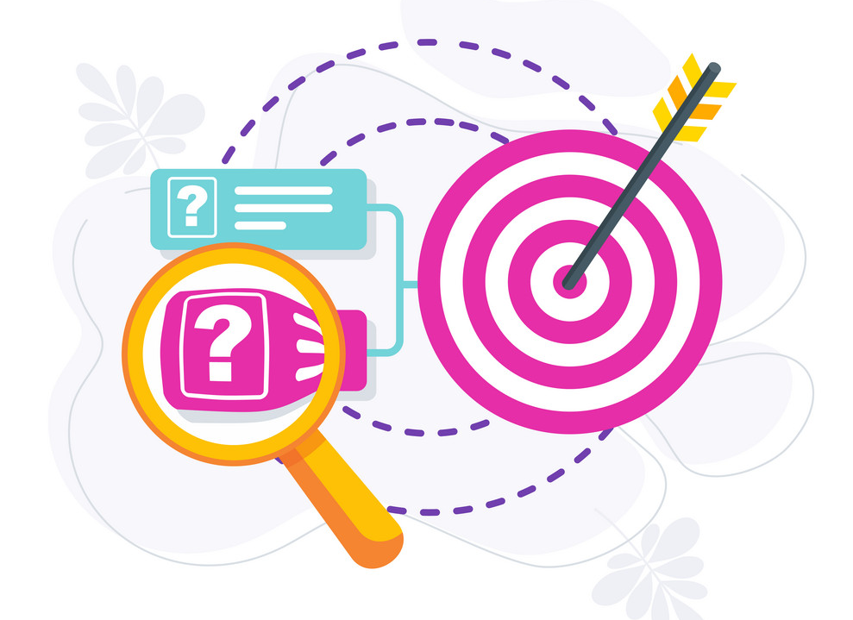

Objectives
Hypothesis
To identify the natural compound as a therapeutic drug/natural remedy using the repurposed drugs for each hub gene associated with the long COVID symptoms.
General Objective
To identify the natural compounds that can be used as therapeutic drug for long COVID based on the hub genes and repurposed drugs using bioinformatics tools.
Specific Objectives
To analyze the hub gene biomarkers for the most common long COVID symptoms
To identify the natural compounds associated with hub genes of each long COVID symptoms
To examine the Molecular Docking between the hub gene biomarkers and natural compounds
What must be achieved in the study??

Slide 7
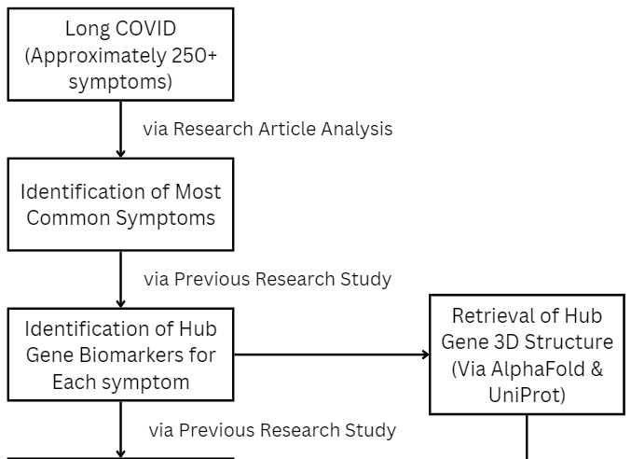
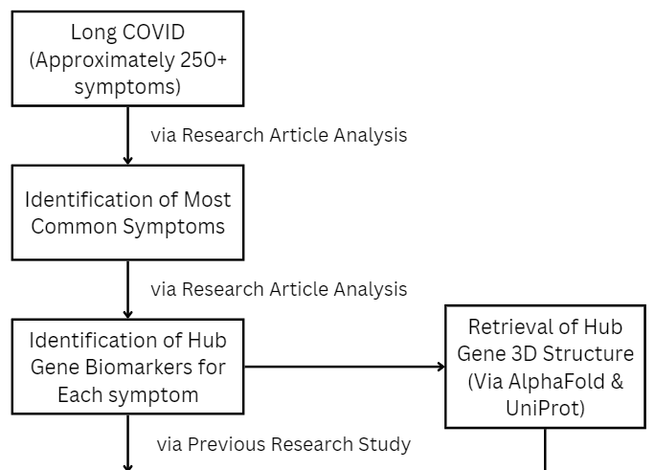
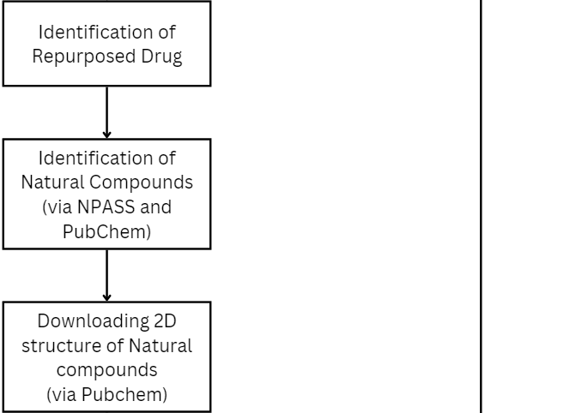
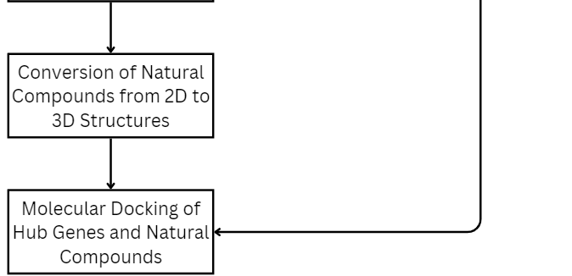
Methodology
Previous Research Study
An article on Long COVID: G Protein-Coupled Receptors (GPCRs) responsible for persistent post-COVID symptoms, by Sanisha Das, Suresh Kumar (Das & Kumar, 2022).
Bioinformatics Tools Employed
PubChem
NPASS
UniProt
AlphaFold
Open Babel
iGEMDOCK

Slide 8
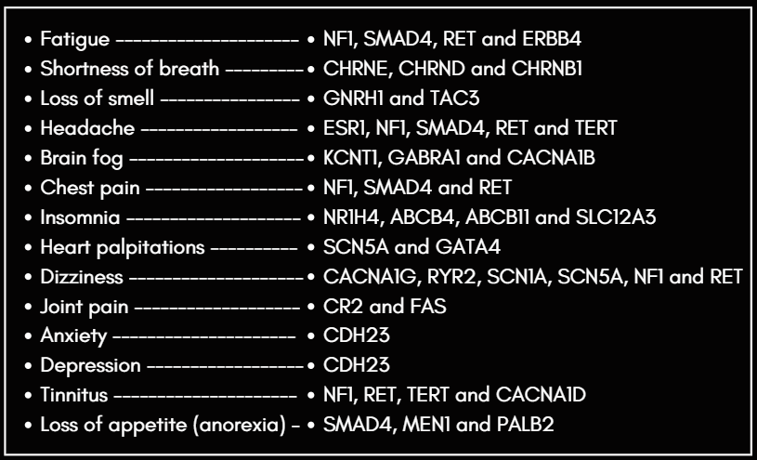
Results
Table 1 - Hub Genes associated with each Long COVID Symptom
Among the total of 17 common long COVID symptoms; 14 symptoms resulted with the presence of at least one Natural Compound using the repurposed drug associated with each hub gene.
NF1, SMAD4 and RET genes appear in more than 2 symptoms.

Slide 9
Results
Table 2 - Molecular Docking of Hub Genes & Natural Compounds
Long COVID Symptom | Highest Negative Energy Docking Result |  | Second Highest Negative Energy Docking Result
Fatigue | RET-NPC56271 | -94.65 | ERBB4-NPC56271 | -94.29
Shortness of Breath | CHRNE-NPC108434 | -106.33 | CHRNB1-NPC10908 | -104.70
Loss of Smell | GNRH1-NPC69843 | -105.95 | GNRH1-NPC322594 | -100.52
Headache | TERT-NPC230098 | -97.62 | ESR1-NPC136948 | -96.97
Brain Fog | CACNA1B-NPC198254 | -119.29 | CACNA1B-NPC473404 | -115.68
Chest Pain | RET-NPC56271 | -94.65 | NF1-NPC117032 | -83.94
Insomnia | ABCB11-NPC100366 | -107.98 | NR1H4-NPC100366 | -97.79
Heart Palpitations | GATA4-NPC101636 | -107.59 | GATA4-NPC100818 | -103.25
Dizziness | RET-NPC56271 | -94.65 | RYR2-NPC122235 | -85.94
Joint Pain | FAS-NPC115624 | -115.52 | FAS-NPC116759 | -115.52
Anxiety | CDH23-NPC67043 | -53.12
Depression | CDH23-NPC67043 | -53.12
Tinnitus | CACNA1D-NPC36836 | -109.75 | TERT-NPC230098 | -97.62
Loss of Appetite (Anorexia) | MEN1-NPC474814 | -114.41 | MEN1-NPC199737 | -95.91
Molecular Docking between the Hub Gene Biomarkers & Natural Compounds.
The hub gene biomarkers are key regulators that play an important role in the biological pathway of their respective symptoms
Identifying the binding affinity via molecular docking of the natural compound, shows the interaction and the potential effects of the compound on the biological pathways regulated by the hub gene.
Thus, aiding in the process new natural remedy development

Slide 10
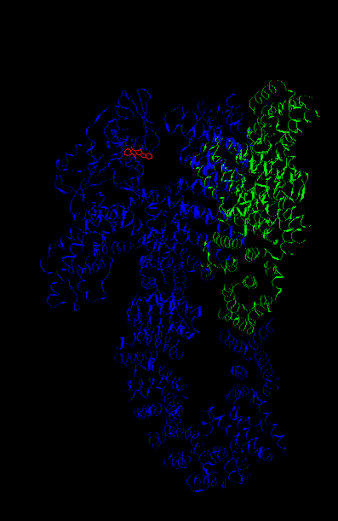
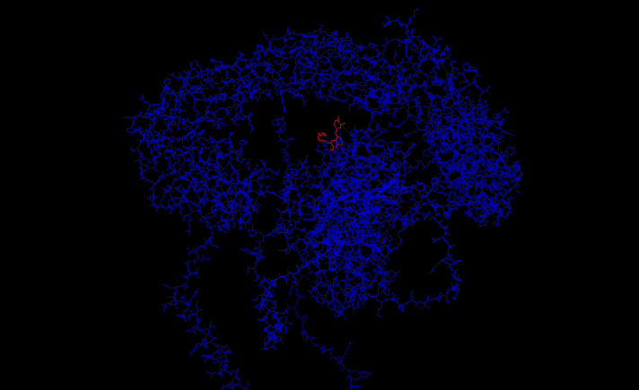
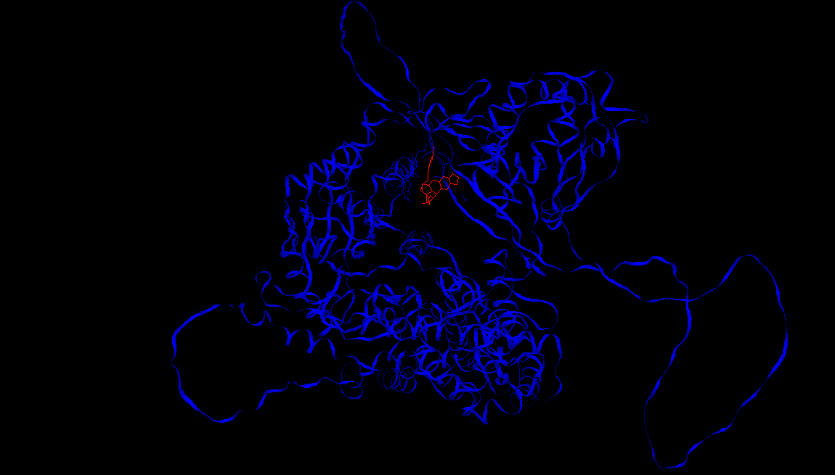
Results
Molecular Docking of the hub gene and natural compound using iGEMDOCK
The red color structure is the natural compound (ligand) and the blue region + green regions are the hub gene (receptor)
RET-NPC56271 (-94.65)
NF1-NPC117032 (-83.94)
TERT-NPC230098 (-97.62)

Slide 11
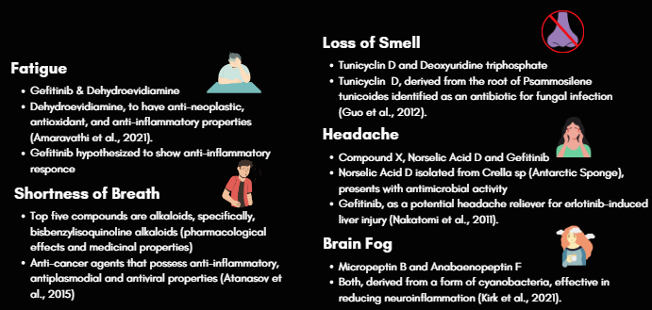
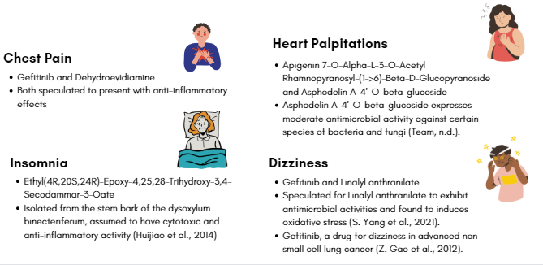
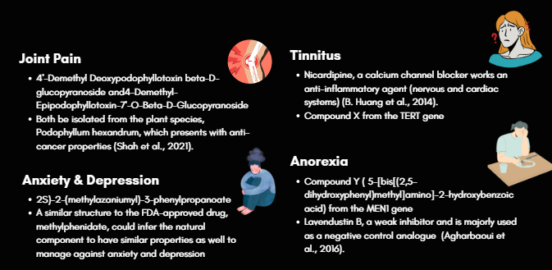
Discussion
Natural Compounds Identified:
Gefitinib (RET Gene)
- Drugs used for non-small cell lung carcinoma
Dehydroevidiamine (NF1 Gene)
- Speculated to have anti-neoplastic, antioxidant, and anti-inflammatory properties
NPC230098 (TERT Gene)
- No information available

Slide 12
Conclusion & Future Perspectives
The identification of natural compounds for long COVID study shows promising potential for improving the symptoms caused by the condition.
Provides an insight and a stable foundation of research on the undiscovered potential of the natural compounds and the unidentified mechanisms of long COVID symptoms.
Aids in the future development of effective therapeutic drugs and interventions catering to each individual symptom based on the hub gene biomarkers and repurposed drugs associated.

Slide 13

References
Akbarialiabad, H., Taghrir, M. H., Abdollahi, A., Ghahramani, N., Kumar, M., Paydar, S., Razani, B., Mwangi, J., Asadi-Pooya, A. A., Malekmakan, L., & Bastani, B. (2021). Long COVID, a comprehensive systematic scoping review. Infection, 49(6), 1163–1186. https://doi.org/10.1007/s15010-021-01666-x
Amaravathi, A., Oblinger, J. L., Welling, D. B., Kinghorn, A. D., & Chang, L. (2021). Neurofibromatosis: Molecular Pathogenesis and Natural Compounds as Potential Treatments. Frontiers in Oncology, 11. https://doi.org/10.3389/fonc.2021.698192
Atanasov, A. G., Waltenberger, B., Pferschy-Wenzig, E., Linder, T., Wawrosch, C., Uhrin, P., Temml, V., Wang, L., Schwaiger, S., Heiss, E. H., Rollinger, J. M., Schuster, D., Breuss, J. M., Bochkov, V. N., Mihovilovic, M. D., Kopp, B., Bauer, R., Dirsch, V. M., & Stuppner, H. (2015). Discovery and resupply of pharmacologically active plant-derived natural products: A review. Biotechnology Advances, 33(8), 1582–1614. https://doi.org/10.1016/j.biotechadv.2015.08.001
Atanasov, A. G., Zotchev, S. B., Dirsch, V. M., & Supuran, C. T. (2021). Natural products in drug discovery: advances and opportunities. Nature Reviews Drug Discovery, 20(3), 200–216. https://doi.org/10.1038/s41573-020-00114-z
Castanares-Zapatero, D., Chalon, P., Kohn, L., Dauvrin, M., Detollenaere, J., De Noordhout, C. M., Jong, C., Cleemput, I., & Van Den Heede, K. (2022). Pathophysiology and mechanism of long COVID: a comprehensive review. Annals of Medicine, 54(1), 1473–1487. https://doi.org/10.1080/07853890.2022.2076901
Das, S., & Kumar, S. (2022). Long COVID: G Protein-Coupled Receptors (GPCRs) responsible for persistent post-COVID symptoms. bioRxiv (Cold Spring Harbor Laboratory). https://doi.org/10.1101/2022.12.12.520110
Davis, H. E., McCorkell, L., Vogel, J., & Topol, E. J. (2023). Long COVID: major findings, mechanisms and recommendations. Nature Reviews Microbiology. https://doi.org/10.1038/s41579-022-00846-2
Deer, R. R., Rock, M. A., Vasilevsky, N., Carmody, L. C., Rando, H. M., Anzalone, A. J., Basson, M. D., Bennett, T. D., Bergquist, T., Boudreau, E. A., Bramante, C. T., Byrd, J. B., Callahan, T. J., Chan, L. M., Chu, H., Chute, C. G., Coleman, B., Davis, H. M., Gagnier, J., . . . Robinson, P. N. (2021). Characterizing Long COVID: Deep Phenotype of a Complex Condition. EBioMedicine, 74, 103722. https://doi.org/10.1016/j.ebiom.2021.103722
Raveendran, A. V., Jayadevan, R., & Sashidharan, S. (2021). Long COVID: An overview. Diabetes and Metabolic Syndrome: Clinical Research and Reviews, 15(3), 869–875. https://doi.org/10.1016/j.dsx.2021.04.007
Roca-Fernandez, A., Wamil, M., Telford, A., Carapella, V., Borlotti, A., Monteiro, D., Thomaides-Brears, H., Dennis, A., Banerjee, R., Robson, M. D., Lip, G. Y. H., Bull, S., Heightman, M., Ntusi, N., & Banerjee, A. (2022). Cardiac impairment in Long Covid 1-year post SARS-CoV-2 infection. European Heart Journal, 43(Supplement_2). https://doi.org/10.1093/eurheartj/ehac544.219
Gao, Z., Han, B., Wang, H., Shi, C., Xiong, L., & Gu, A. (2012). Clinical observation of gefitinib as a first-line therapy in sixty-eight patients with advanced NSCLC. Oncology Letters, 3(5), 1064–1068. https://doi.org/10.3892/ol.2012.631
Garg, P., Ahuja, V., Kumar, A., & Wig, N. (2021). The “post‐COVID” syndrome: How deep is the damage? Journal of Medical Virology, 93(2), 673–674. https://doi.org/10.1002/jmv.26465
Guo, J., Wu, W., Zhang, C., Yang, G., Xu, M., & Hu, H. (2012). First total synthesis of antifungal cyclopeptide tunicyclin d by a solid-phase method. Chemistry of Natural Compounds, 48(3), 447–450. https://doi.org/10.1007/s10600-012-0270-9
Huang, B., Chang, P., Yeh, W., Lee, C., Tsai, C., Lin, C., Lin, H., Liu, Y., Wu, C., Ko, P., Huang, S., Hsu, H., & Lu, D. (2014). Anti-Neuroinflammatory Effects of the Calcium Channel Blocker Nicardipine on Microglial Cells: Implications for Neuroprotection. PLOS ONE, 9(3), e91167. https://doi.org/10.1371/journal.pone.0091167
Huijiao, Y., Wang, J., & Kong, L. (2014). Cytotoxic Dammarane-Type Triterpenoids from the Stem Bark of Dysoxylum binecteriferum. Journal of Natural Products, 77(2), 234–242. https://doi.org/10.1021/np400700g
Kirk, R. D., He, H., Wahome, P. K., Wu, S., Carter, G. T., & Bertin, M. J. (2021). New Micropeptins with Anti-Neuroinflammatory Activity Isolated from a Cyanobacterial Bloom. ACS Omega, 6(23), 15472–15478. https://doi.org/10.1021/acsomega.1c02025
Nakatomi, K., Nakamura, Y., Tetsuya, I., & Kohno, S. (2011). Treatment with gefitinib after erlotinib-induced liver injury: a case report. Journal of Medical Case Reports, 5(1). https://doi.org/10.1186/1752-1947-5-593
Shah, Z., Gohar, U. F., Jamshed, I., Mushtaq, A., Mukhtar, H., Zia-Ui-Haq, M., Toma, S. I., Manea, R., Moga, M., & Popovici, B. (2021). Podophyllotoxin: History, Recent Advances and Future Prospects. Biomolecules, 11(4), 603. https://doi.org/10.3390/biom11040603
Team, E. W. (n.d.). asphodelin A-4’-O-beta-glucoside (CHEBI:65454). https://www.ebi.ac.uk/chebi/searchId.do?printerFriendlyView=true&locale=null&chebiId=65454&viewTermLineage=null&structureView=&
World Health Organization: WHO. (2020). Coronavirus. www.who.int. https://www.who.int/health-topics/coronavirus#tab=tab_1
Yang, S., Yusoff, K., Ajat, M., Yap, W. S., Lim, S. H., & Lai, K. (2021). Antimicrobial activity and mode of action of terpene linalyl anthranilate against carbapenemase-producing Klebsiella pneumoniae. Journal of Pharmaceutical Analysis, 11(2), 210–219. https://doi.org/10.1016/j.jpha.2020.05.014

Slide 14




